Slide 1

February 14, 2019
Wifi: 1393Conference
Password: kayla1393

Slide 2

Welcome & Introductions
Cathryn Beeman, CHES, CLC
Outreach assistant
cbeeman@nshc.org
(631) 257-6964
www.lihealthcollab.org

Slide 3
LIPHIP Advocacy Update
Governor Cuomo has proposed the elimination of PHIP funding, updates include:
    The PHIP grant was scheduled to end January 2020, but the proposal would end the program in April 2019
      According to the governor’s office, if the legislature includes PHIP funding in the upcoming budget, their office will not oppose it
www.lihealthcollab.org

Slide 4
Community Health Needs Assessments
Paul Love, MPH
Data Analyst
plove@nshc.org
(631) 257-6956
www.lihealthcollab.org

Slide 5
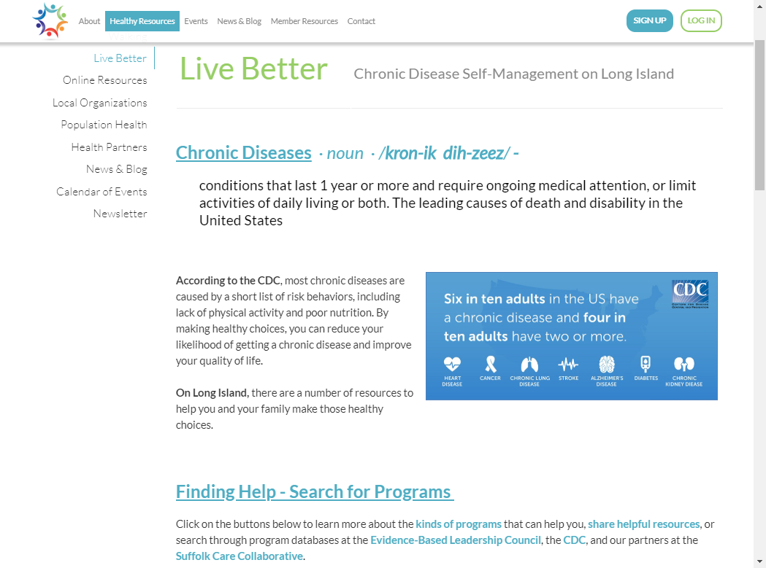
Chronic Disease Awareness Campaign
Webpage – lihealthcollab.org/LiveBetter [link]
Shareable
videos
www.lihealthcollab.org

Slide 6
Long Island’s Healthy Libraries
Two dedicated pages on www.lihealthcollab.org
Population Health Summit VI: “Becoming the Healthiest State for People of All Ages - Incorporating Health Across all Policies and Age Friendly principles into the Prevention Agenda 2019 - 2024”
www.lihealthcollab.org

Slide 7
Background
Beyond Books: Public Libraries As Partners For Population Health
University of Pennsylvania study found libraries are more than books
  Well positioned to be partners in culture of health
  Address social determinants of health
  Trusted institutions that have population reach
  Untapped potential to improve population health
www.lihealthcollab.org

Slide 8
Goals
Identify health related programs offered at libraries throughout Nassau and Suffolk Counties
Align them to Kaiser Family Foundation’s six social/behavioral determinants of health and the Prevention Agenda Priority Areas
Create TWO Library Programming Information Data Visualization in the form of an Interactive Map
  One for Research Use
  One for Public Use
www.lihealthcollab.org

Slide 9
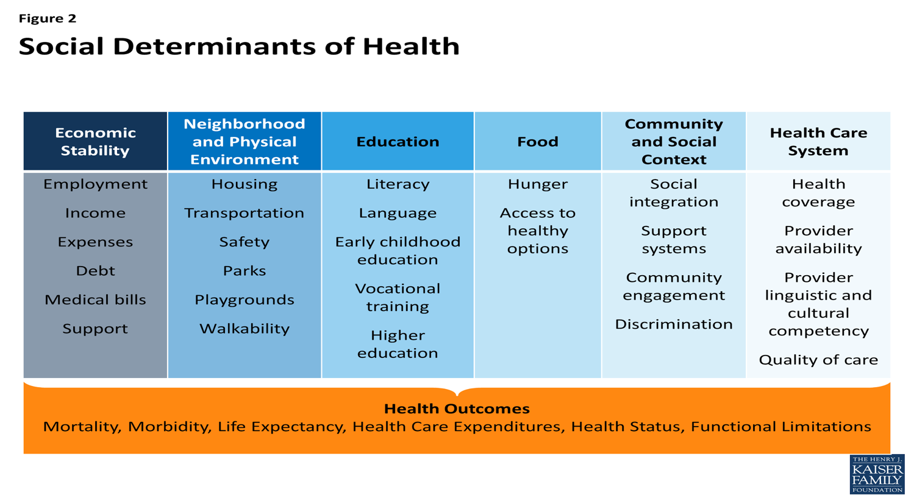
Kaiser Family Foundation’s Six Social/Behavioral Determinants of Health
www.lihealthcollab.org

Slide 10
Data Collection/Data Analyses Methods
Environmental Scans of programs offered by libraries in Nassau (n=59) and Suffolk (n=62) Counties
  Calendar Years 2016-2018
  Sources of Program Data: Publically accessible newsletters, calendars, pamphlets, flyers, etc.
Content analysis was conducted for every program
  Programs were then linked/matched to the appropriate health priority topics and/or social determinants of health
  Programs could:
    Be linked to more than one PA Priority Area
    Be linked to more than one Social Determinant of Health
    Be linked to BOTH a PA Priority Area
    and Social Determinant of Health
    Be linked to NONE
Data collection and analyses were completed by MPH students from SBU and Hofstra
www.lihealthcollab.org

Slide 11
ArcGIS Mapping Software
Library and program information were compiled into a spreadsheet
Using the mapping software ArcGIS, two interactive layered maps were created
Maps have 12 layers, including
  Library Info (Name, Address, Phone Number, Website, etc.)
  5 Layers for PA Priority Topics
  6 Layers for Social/Behavioral Determinants of Health
Maps show which libraries offer programs tailored to these PA Priority Area and/or social determinants of health
www.lihealthcollab.org

Slide 12
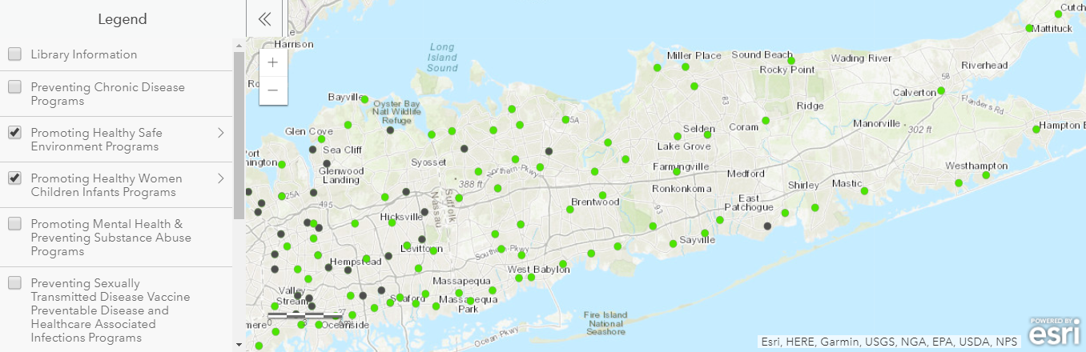
Interactive Map: Public Use
Living on the Long Island Health Collaborative website, this map can be used as a tool for Long Island residents to identify basic library information, and determine whether or not the library offers health and social support programs based on a PA
Priority Area
or social
determinant
of health
www.lihealthcollab.org

Slide 13
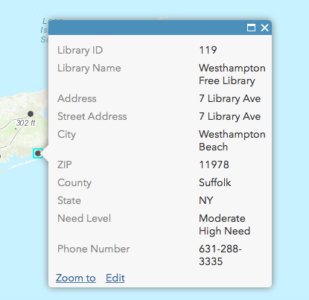
Interactive Map: Research Use
This interactive map of library programs throughout Long Island will serve as a tool for researchers to
identify where and how to improve population health.
This map will include more details of libraries and their programs.
  Need level, links to past program information, etc.
www.lihealthcollab.org

Slide 14
Conclusions
Can be used to identify how libraries are impacting specific public health issues
  Opioid Epidemic
  Obesity
  Food Insecurity
www.lihealthcollab.org

Slide 15



The Opioid Crisis on Long Island –
a Data-Driven
Population Health Approach
Serving the Community, the Nation, the World
Long Island Health Collaborative, February 14, 2019
Notes:
Title Slide

Slide 16
If interested in collaboration, please contact:
Lisa A. Benz Scott, PhD, Professor and Director, Program in Public Health
  Lisa.benzscott@stonybrook.edu
Notes:
Interested in Collaboration, Contact Info

Slide 17
PHIP Advocacy Support Letter
Station near the door!
www.lihealthcollab.org

Slide 18
2019 Meeting Dates
Wednesday, April 10
Wednesday, June 12*
Wednesday, August 7
Wednesday, October 16
Wednesday, December 11
*CHS Melville
www.lihealthcollab.org

Slide 19
Adjournment
www.lihealthcollab.org

